Slide 1
Project 1 – Airbnb Analysis
Jeneen Gnilka, Tim Mandel, Austin Vasquez

Slide 2
Project Overview
Decided on project scope and created proposal
Downloaded and analyzed raw data
Used Pandas in Jupyter Notebook to clean the data
Used Matplotlib to create visualizations of the data
Created write-up summary to showcase major findings

Slide 3
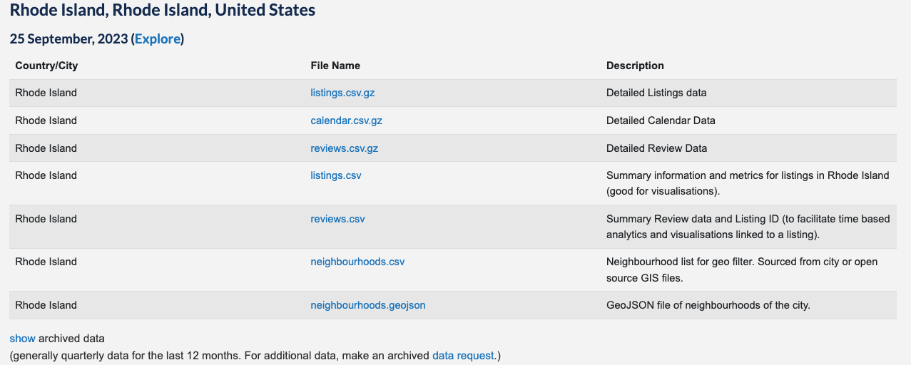
Data Source

Slide 4
Data Analysis by Price
Price by Bedrooms
Price by Beds
Price by Bathrooms
Price by Room Type

Slide 5
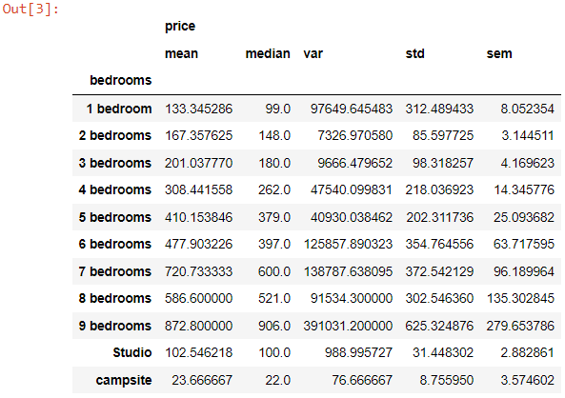
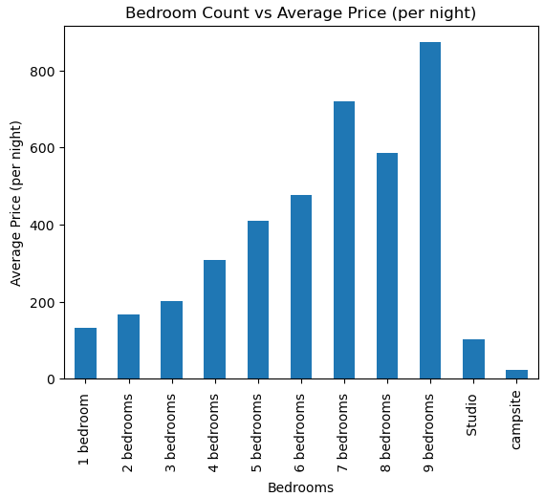
Average Price by # of Bedrooms - Asheville

Slide 6
Average Price by # of Bedrooms – Rhode Island

Slide 7
Average Price by # of Bedrooms - Columbus

Slide 8
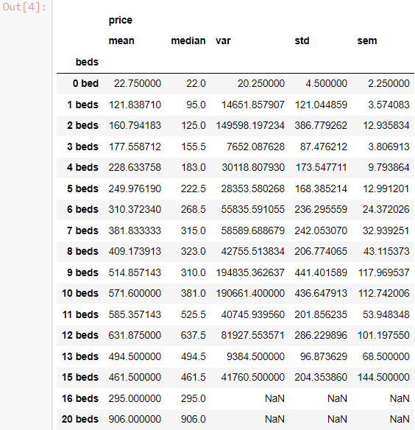
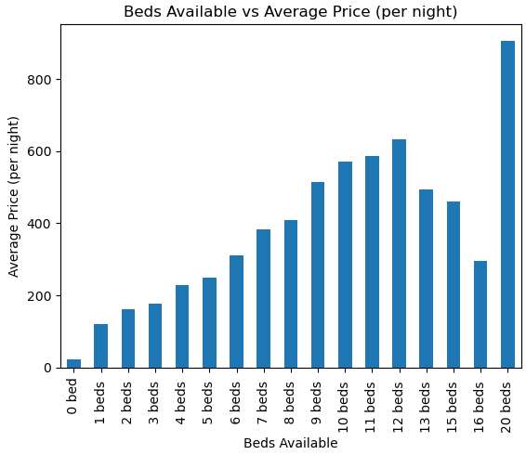
Average Price by # of Beds - Asheville

Slide 9
Average Price by # of Beds – Rhode Island

Slide 10
Average Price by # of Beds – Columbus

Slide 11
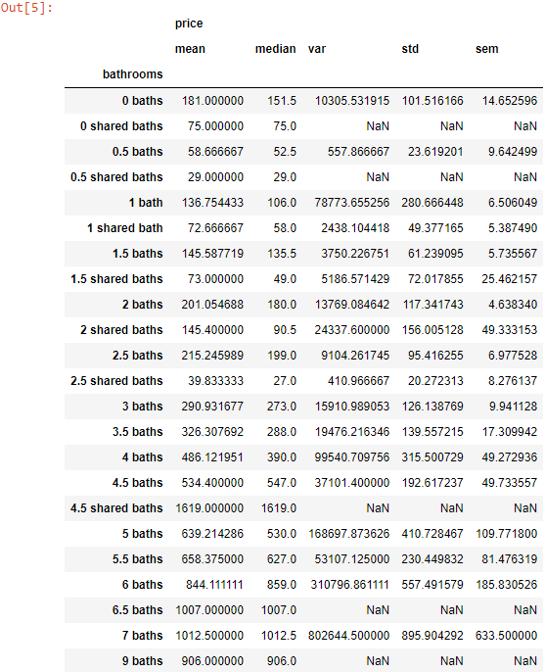
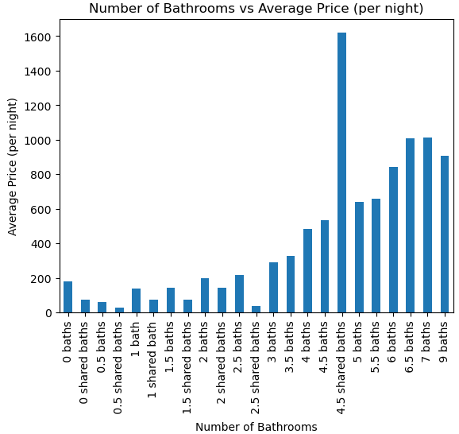
Average Price by # of Bathrooms – Asheville
Outlier(boutique hotel)

Slide 12
Average Price by # of Bathrooms – Rhode Island

Slide 13
Average Price by # of Bathrooms – Columbus

Slide 14
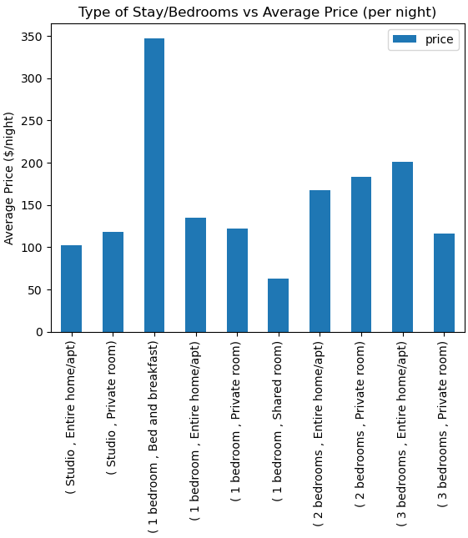
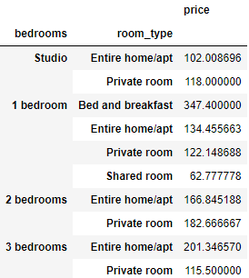
Average Price by Room Types - Asheville

Slide 15
Average Price by Room Types – Rhode Island

Slide 16
Average Price by Room Types – Columbus

Slide 17
Data Analysis by Rating
Rating by Bedrooms/Room Type
Rating of hosts with different total listings

Slide 18
Average Rating for Listings
Asheville
Rhode Island
Columbus

Slide 19
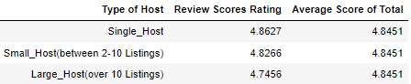
Average scores of hosts with different total listings

Slide 20
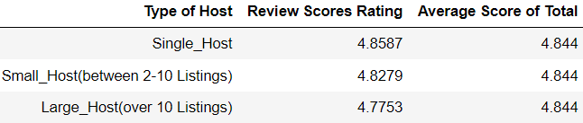
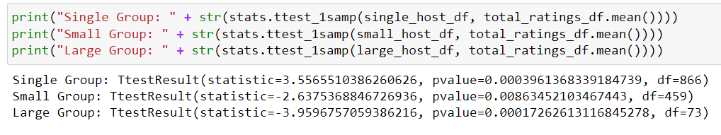
Statistical Analysis
Asheville

Slide 21
Statistical Analysis
T-Test

Slide 22
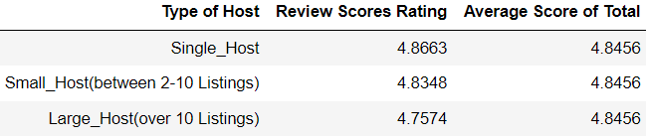
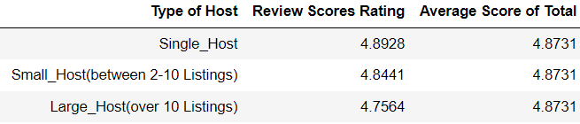
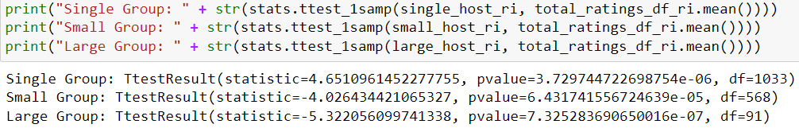
Statistical Analysis
Columbus
Rhode Island

Slide 23
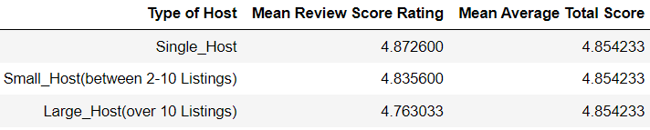
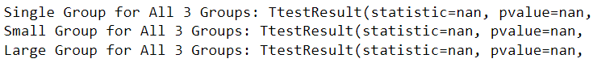
Statistical Analysis
All Three Groups Combined
No statistical Significance

